Slide 1
Internship Report
Company : Tata Steel
By Krishna Deshpande
VIT
2023

Slide 2
Tasks completed
Data Analysis on data of Sinter Plant of Tata Steel
House Prices Data Analysis

Slide 3
Sinter Plant process
I had the golden opportunity to learn about this process.
I got to know in detail about this process and how the plant utilizes its resources to produce maximum output.
Controlled Sintering:
  Heat (1300-1480°C) binds small iron ore and coke on a conveyor.
  Manages air exposure to avoid melting and maintain cohesion.
Precise Temperature Management:
  Gradually raises temperature to prevent iron agglomeration.
Crushing for Furnace Readiness:
  Spike crusher sizes iron sinter for blast furnace.
  Emphasizes key process factors: conveyor speed, ore-coke ratio, temperature, and ore size.
All the details of the process are mentioned in the Sinter plant analysis report.

Slide 4
Tata Steel Sinter Plant data analysis
This dataset had a special data which was skewed. It was a feature of the dataset which I was told to analyze.
I had a long time with the choosing of the appropriate ML model for this task. Many of them fit very poorly with the data given.
I learned how to tackle overfitting with this task by changing the parameters, random seed and experimenting with the optimization techniques.

Slide 5
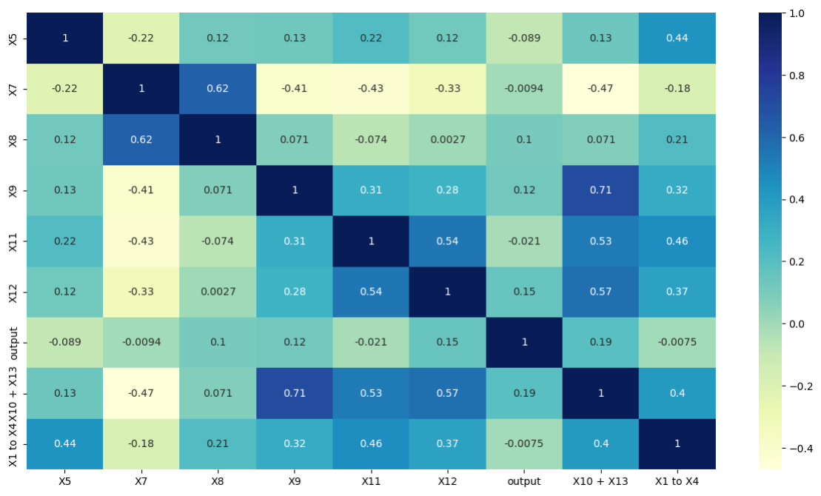
Sinter Plant data analysis
I learned in depth the use of correlation measures and how to visualize their relations with each other using heatmaps.
Feature Creation was a new topic which I didn’t know before. I found it very useful.
After I got the knowledge of understanding the correlation heatmaps, I had the chance to understand and implement feature selection.
Using this new knowledge I reduced 1/3rd of the columns which were very similar with each other.

Slide 6
House Prices Analysis
Learned the basics of Data Analysis.
Got to know the many ML models we can use to do analysis.
Parameterization was a very important topic I didn’t know before. I got the opportunity to understand and implement it in this task.
Model Optimization techniques was a key takeaway from the work.
GridSearchCV, RandomisedSearchCV and k-fold validation are important methods used in Data Analysis.
Overfitting is a very important topic to be looked into. I had a lot of trouble with this during my initial period of data analysis.

Slide 7
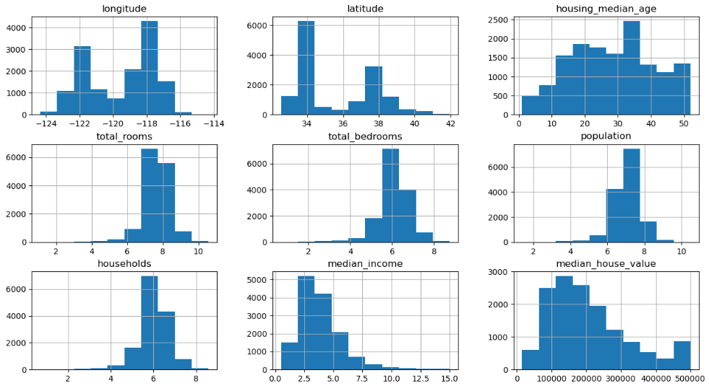
House Prices Analysis
Data Preprocessing and Cleaning is not easy and is very important in the beginning. If that is not done properly, the ML model won’t be able to give the desired result.

Slide 8
Thank you for this golden opportunity

